Slide 1
BI Unit IV- Part 2
Presented by: Drashti Shrimal1 Topic: Data Mining, its Properties and Tasks

Slide 2
Topics:
- Data Mining Architecture
- Data Mining Process

Slide 3
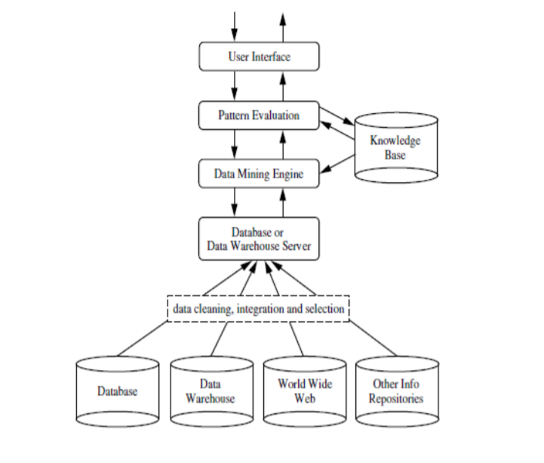
Data Mining Architecture

Slide 4
Data Mining Architecture
1. Knowledge Base:
This is the domain knowledge that is used to guide the search orevaluate the
interestingness of resulting patterns. Such knowledge can include concepthierarchies, used to organize attributes or attribute values into different levels of abstraction.
2. Data Mining Engine:
This is essential to the data mining systemand ideally consists ofa set of functional modules for tasks such as characterization, association and correlation analysis, classification, prediction, cluster analysis, outlier analysis, and evolutionanalysis.

Slide 5
Data Mining Architecture
3. Pattern Evaluation:
This component typically employs interestingness measures interacts with the data mining modules so as to focus thesearch toward interesting patterns. It may use interestingness thresholds to filterout discovered patterns.
4. User Interface:
This componentallows the user to browse database and data warehouse schemas or data structures,evaluate mined patterns, and visualize the patterns in different forms.

Slide 6
Data Mining Architecture
Other modules are:
Data Cleaning- filtering the data from the warehouse, www and other repositories.
Data Integration- Merge all the various cleansed data.
Data Selection- Select the required data.

Slide 7
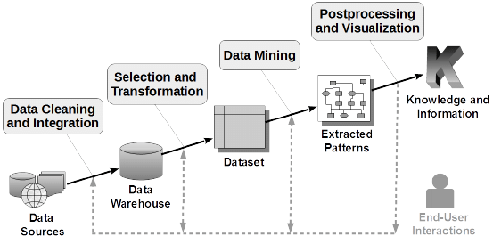
Data Mining Process

Slide 8
Data Mining Process
Data Cleaning - In this step the noise and inconsistent data is removed.
Data Integration - In this step multiple data sources are combined.
Data Selection - In this step relevant to the analysis task are retrieved from the database.
Data Transformation - In this step data are transformed or consolidated into forms appropriate for mining by performing summary or aggregation operations.
Data Mining - In this step intelligent methods are applied in order to extract data patterns.
Pattern Evaluation - In this step, data patterns are evaluated.
Knowledge Presentation - In this step,knowledge is represented.

